Slide 1

If Then Else
Lesson 9

Slide 2
Program Flow Discussion
Do computer programs always take the same route through the code?
When code is run line by line, in the same order every time this is known as sequence or program flow
Notes:
Draw out from learners that someone code will only need to be run if a certain condition is true. You may want to ask learners to think back to the maths program which they completed on the micro:bit. The question appeared when they pressed Button A whereas the answer appeared when they pressed Button B. Different code was run depending on different conditions.

Slide 3
Program Flow
There will be times when a computer program will only need to do a certain task if a condition is true
For example, think about getting dressed – what could cause you to dress differently?

Slide 4
Getting Dressed Algorithm
Depending on the weather you may wish to dress differently. If we were to write this as an algorithm using a flow chart what shape would we use for a decision?
Our basic getting dressed algorithm could look like this:
As you can see from the flow chart:
You would only put on trousers if it is not warm
You would put on shorts if it is warm, taking a different route through the decision
Start
Is it warm?
No
Put on trousers
Yes
Put on shorts
End

Slide 5
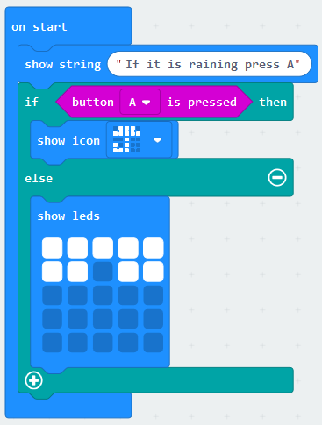
The micro:bit – If Then Else
If then else statements on the MakeCode website appear in the logic group, for example:
If Button A is pressed and held down
Then the icon of an umbrella will be shown
Else (ie If Button A isn’t pressed) an icon of a pair of sunglasses will be displayed
A different route is taken through the program depending on if the Button A is pressed or not
Try to create your own program in MakeCode using at least one if, then, else statement

